Slide 1
PRESENTATION OVERVIEW
Sales Dashboard & Customer Insights Analysis
Dashboard performance, customer trends, and key insights.
Page 1

Slide 2
Objective
Focus the analysis on sales performance, customer behavior, and actionable dashboard insights.
1
2
3
4
Analyze Sales Performance
Identify Customer Behavior
Generate Business Insights
Build Interactive Dashboard
Track revenue trends.
Spot key segments.
Turn findings into actions.
Support exploration and decisions.
Page 2

Slide 3
Dataset Overview
Six core datasets provide a complete view of business performance, customer behavior, and product activity.
Orders
Regions
Transaction records and purchase activity.
Performance by market.
Customers
Sales
Profiles, segments, and behavior.
Revenue, quantities, and performance.
Products
Profit
Categories, attributes, and item details.
Margins and profitability.
Page 3

Slide 4
Data Cleaning
Clean data is accurate, consistent, and ready for analysis.
Core Quality Checks
Standardization
Data Integrity
Quality Refinement
Converted dates
Standardized formats
Normalized values
Validated relationships
Checked consistency
Confirmed unique keys
Removed duplicates
Checked missing data
Validated types
Handled outliers
Reviewed anomalies
Prepared for analysis
Page 4

Slide 5
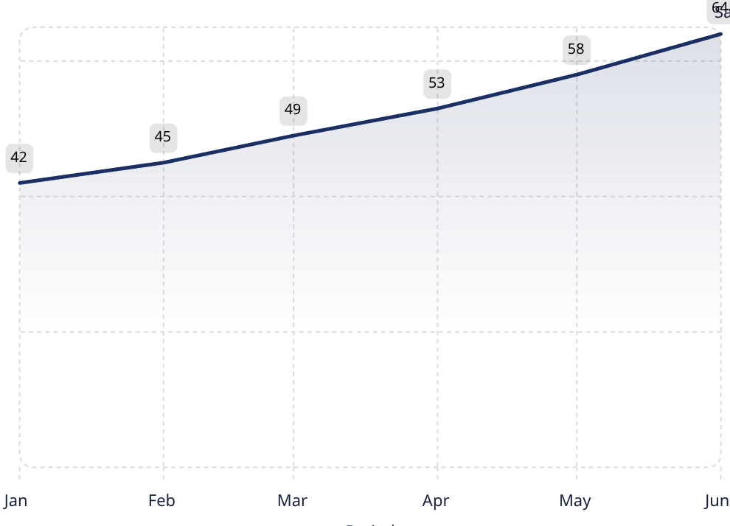
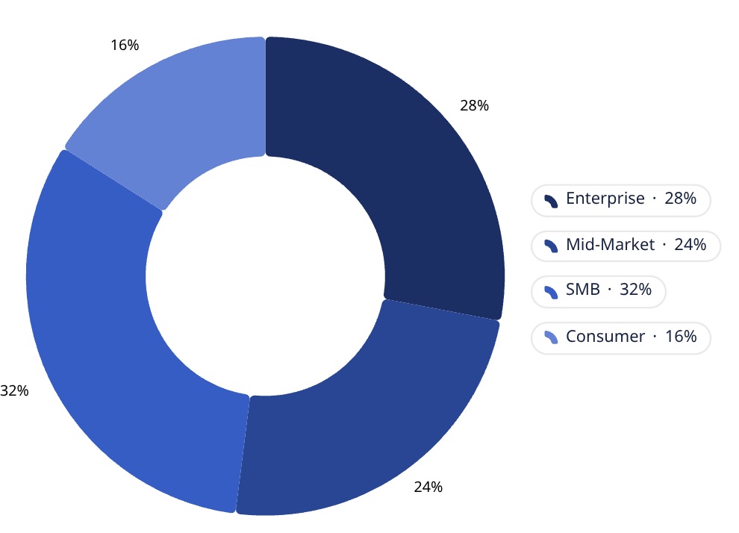
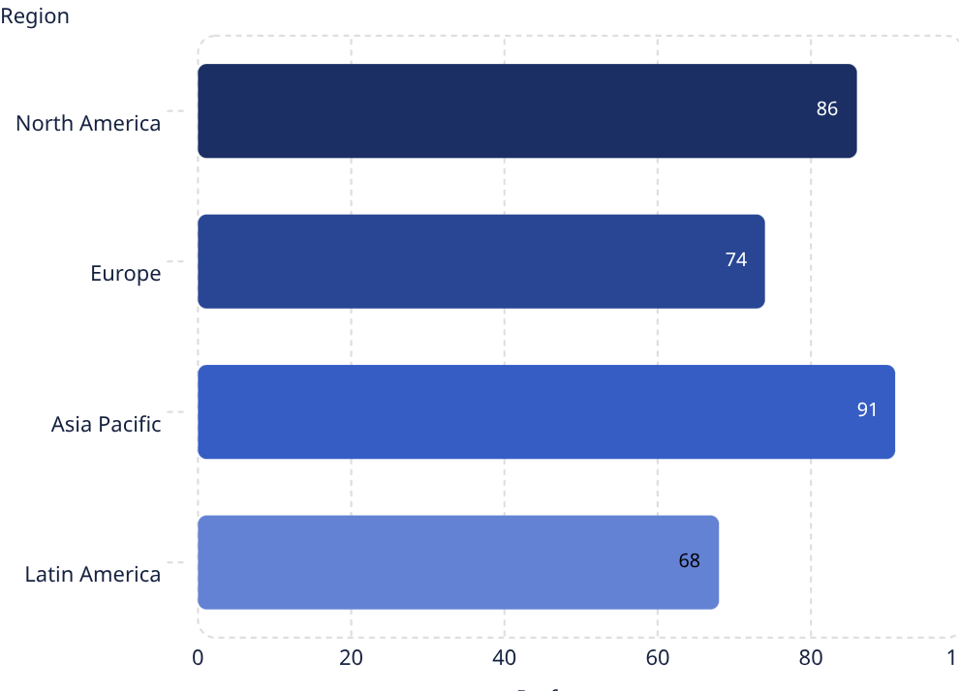
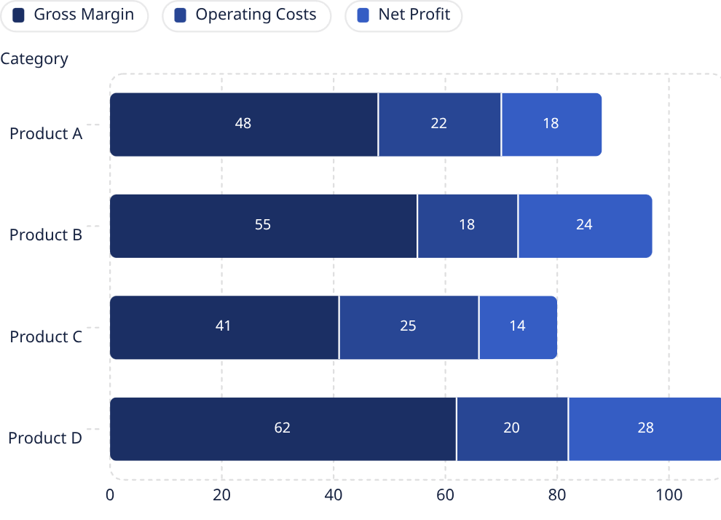
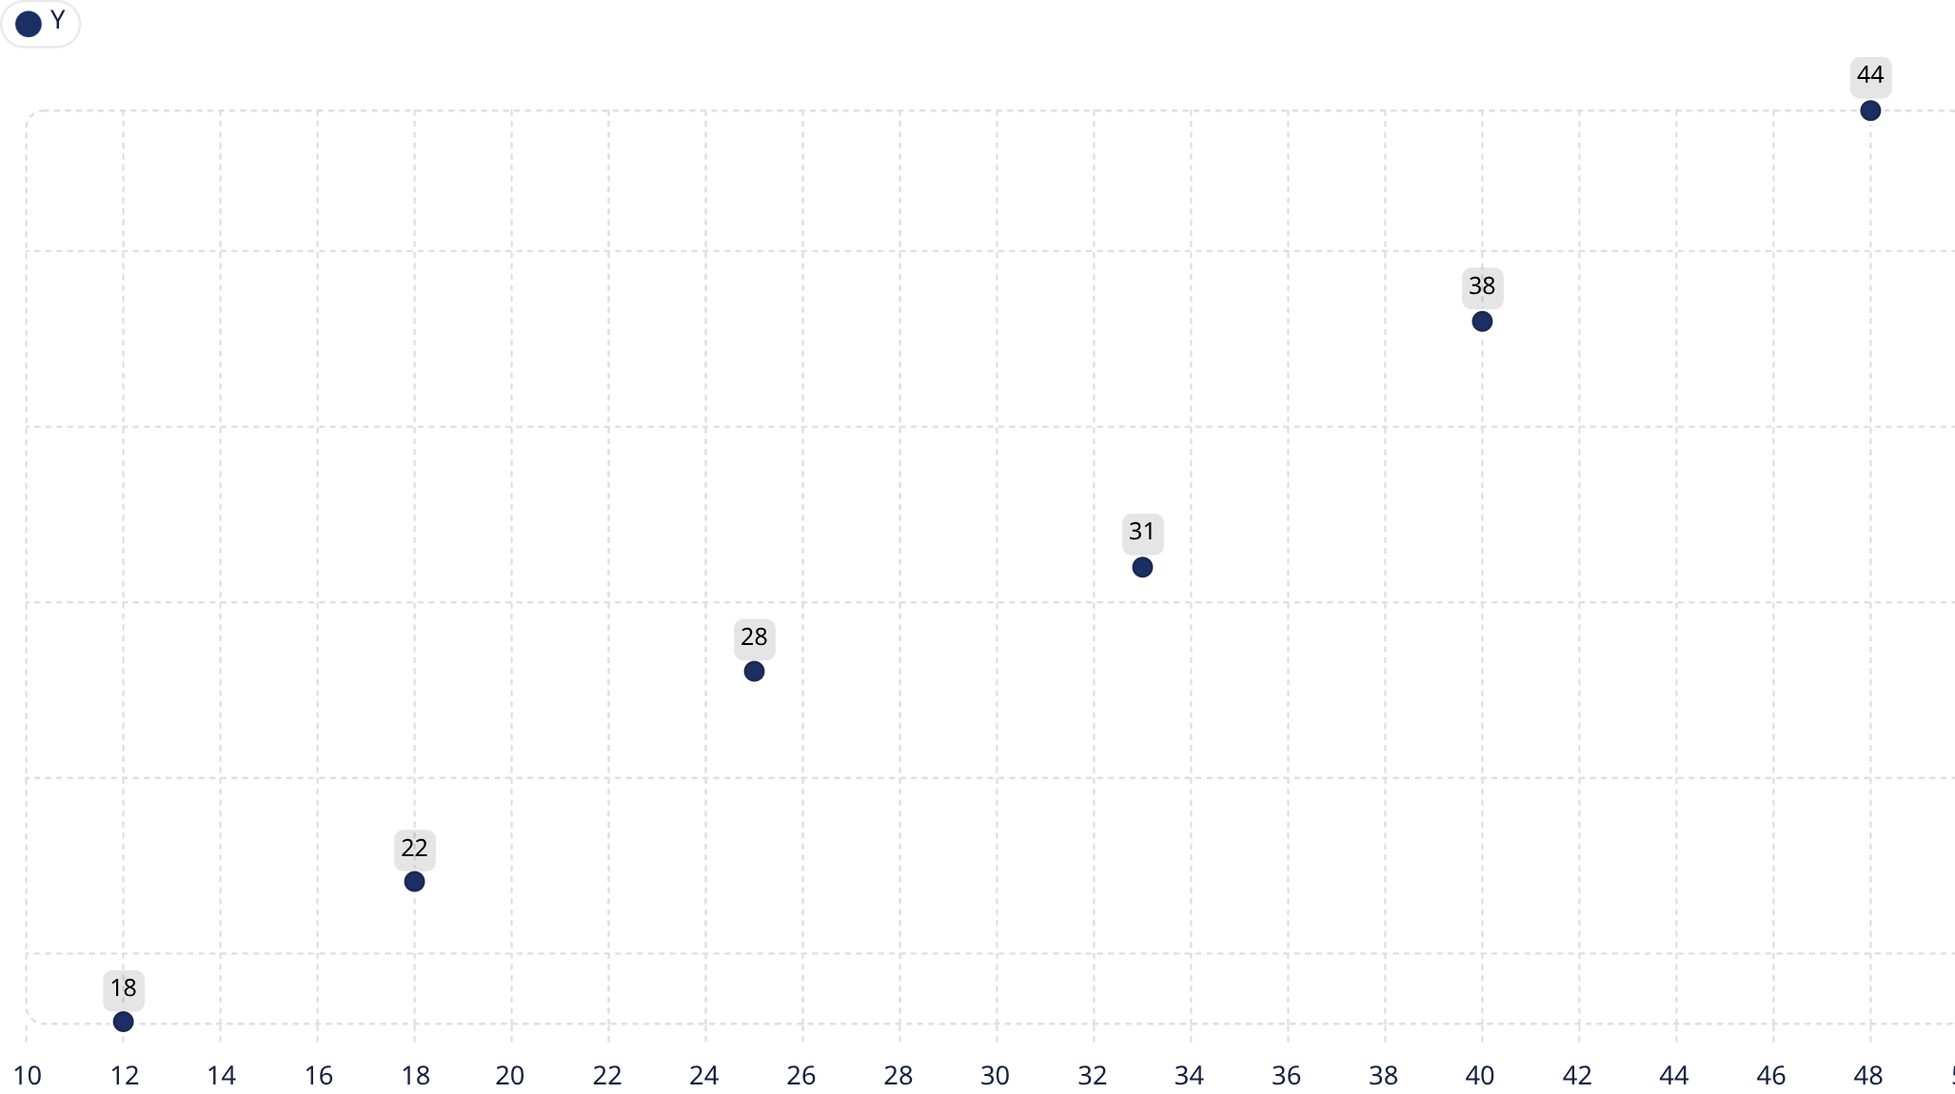
Analysis Performed
Exploratory review, segmentation, and performance comparison revealed key patterns and drivers of change.
Sales Trend Analysis
Customer Segmentation
Regional Performance
Profitability Analysis
Correlation Analysis
Page 5

Slide 6
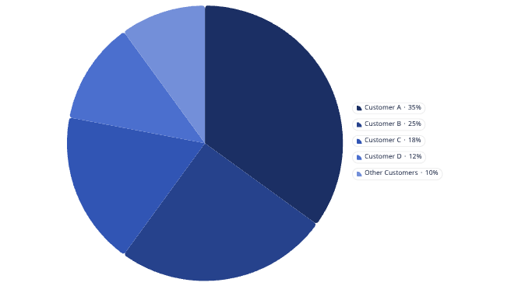
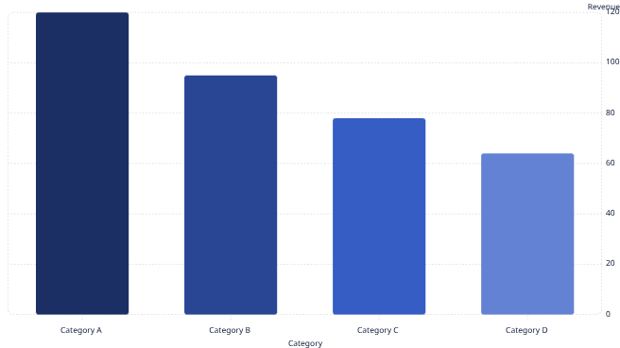
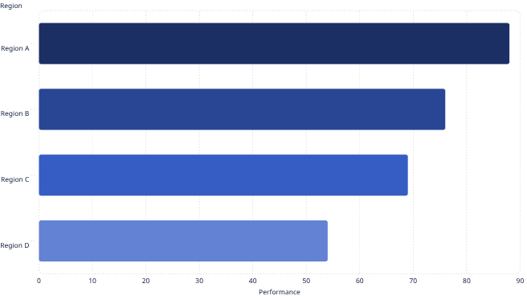
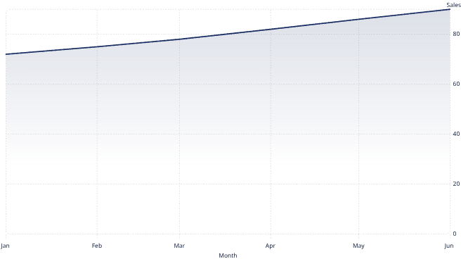
Insights
The analysis highlights clear areas of strength across product performance, regional momentum, customer concentration, and month-over-month growth.
Highest Sales Category
Best-performing Region
Top Customers
Monthly Sales Growth
Revenue is concentrated among a small set of high-value customers, reinforcing the importance of retention.
The top-performing product category drives the largest share of revenue and should remain a priority.
One region is outperforming peers, making it a strong source of scalable momentum.
Sales have shown steady month-over-month gains, signaling healthy demand and improving execution.
Page 6

Slide 7
Business Recommendations
Focus on the actions most likely to improve retention, expand growth, and strengthen product performance.
Customer Retention
Regional Expansion
Product Optimization
Strengthen loyalty and reduce churn among high-value accounts.
Prioritize high-momentum markets to accelerate growth.
Improve assortment and promotions to boost margin and ROI.
Page 7

Slide 8
Deployment & References
The project is easy to access, review, and reproduce.
GitHub Repository
Technical Requirements
Source code and project files.
https://github.com/keerthikabheemaraj/customer_sales_board
Python and the notebook/Streamlit packages.
Live Dashboard
Documentation
Interactive Streamlit app.
https://customersalesboard-ftnubggesfgehjoubcgu8z.streamlit.app/
Repository files and notebook include setup guidance.
Support Resources
Notebook
Use the repository and notebook for troubleshooting.
Full analysis and development notebook.
https://github.com/keerthikabheemaraj/customer_sales_board/blob/main/mini_project3.ipynb
Page 8

